Slide 1
Makati 2025: Fast-Tracking Progress
Hon. Mar-Len Abigail S. Binay
Rotary Club of Manila Luncheon Meeting
July 11, 2019
New World Hotel, Makati City

Slide 2
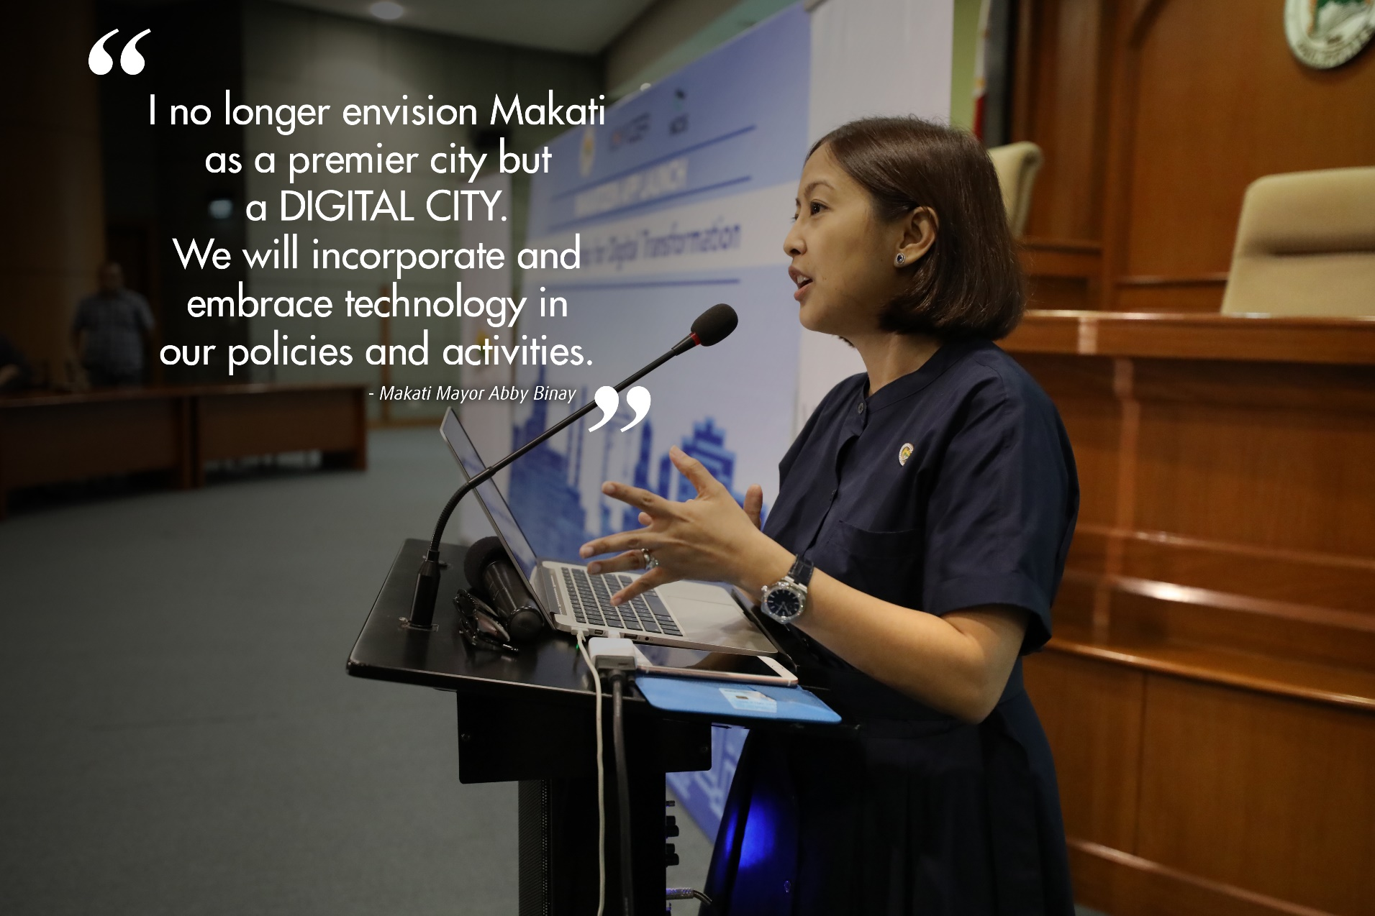

Slide 3
Major Achievements
and Plans for a Smart Makati

Slide 4
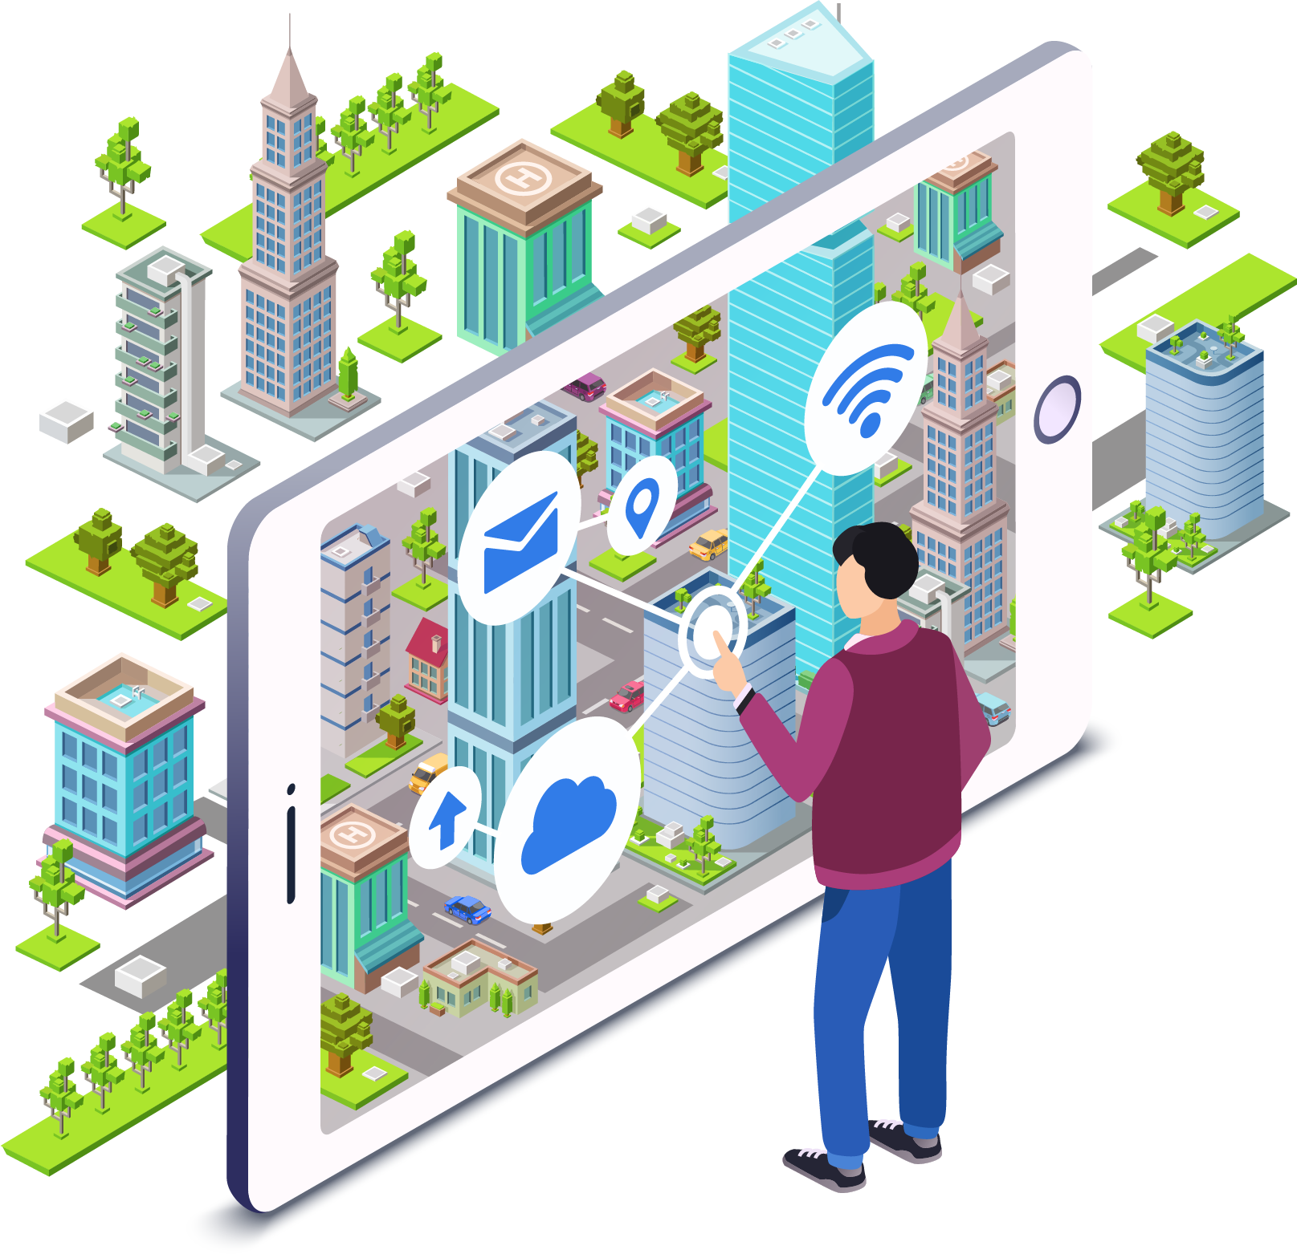
Makati: Digital City

Slide 5
Enhanced Ease of Doing Business
Business One-Stop Shop (BOSS)
Streamlined Processes
Downloadable Forms
Intensified Drive versus Fixers

Slide 6
Two-digit increase in revenue collections
12% increase in 2017
2
0
1
7

Slide 7
Actual
Collection
P12.1 Billion
(As of May 2019)
71% Attained

Slide 8
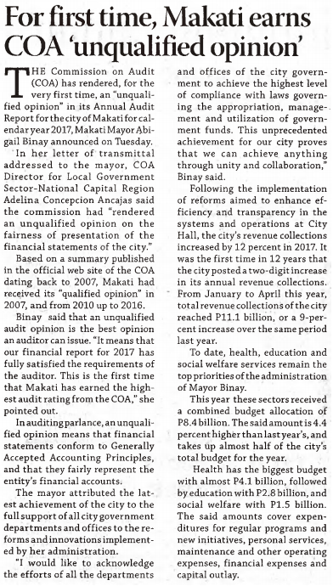
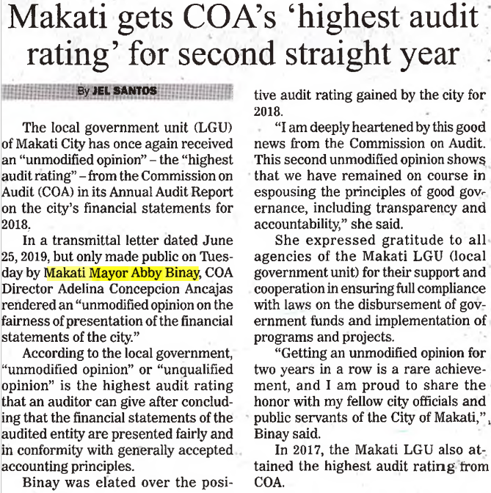
Highest COA Audit Rating
(2017 and 2018)

Slide 9
Richest Local Government Unit
P196.57 Billion in Assets

Slide 10
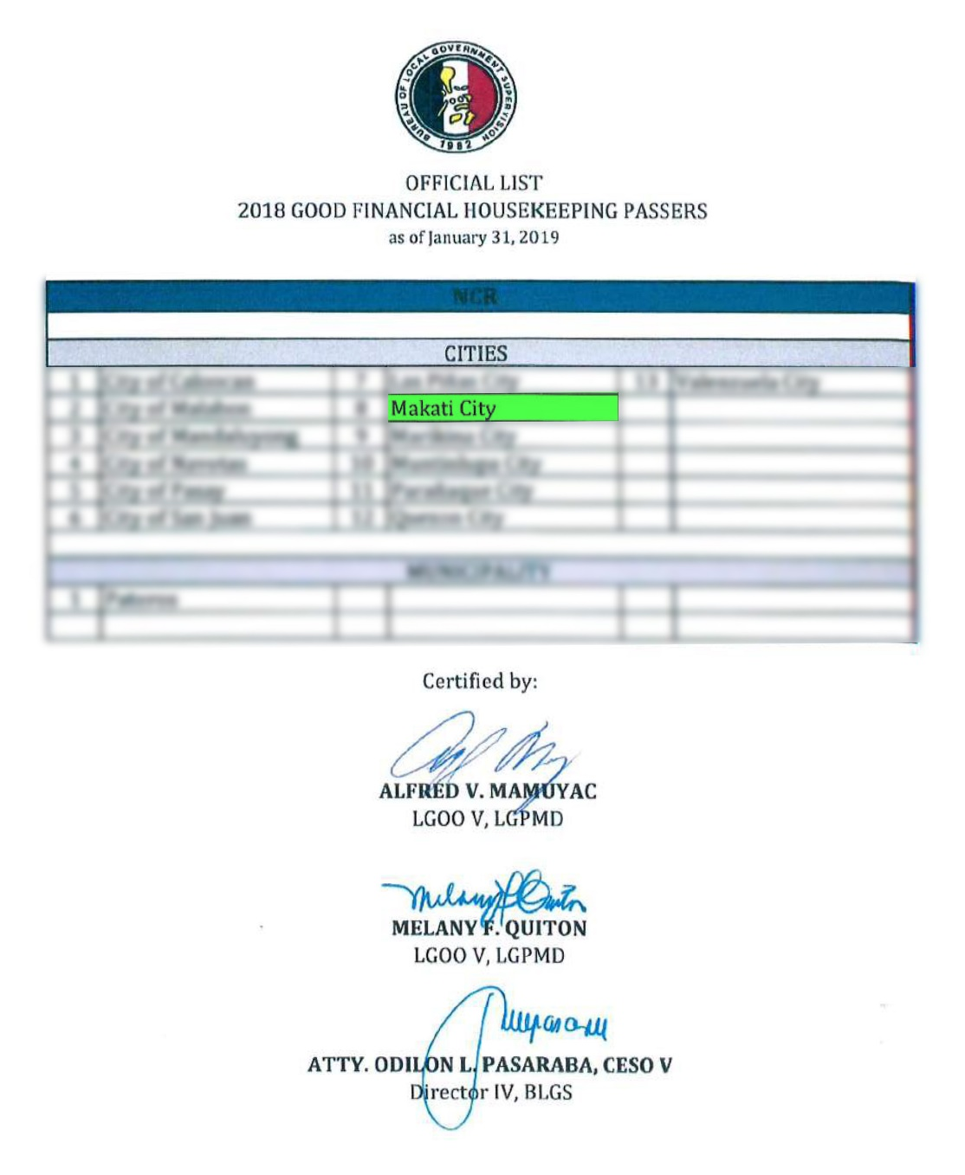
DILG Seal of
Good Financial Housekeeping

Slide 11
Champion City in the Best in eGov Digital Financial Empowerment Category

Slide 12
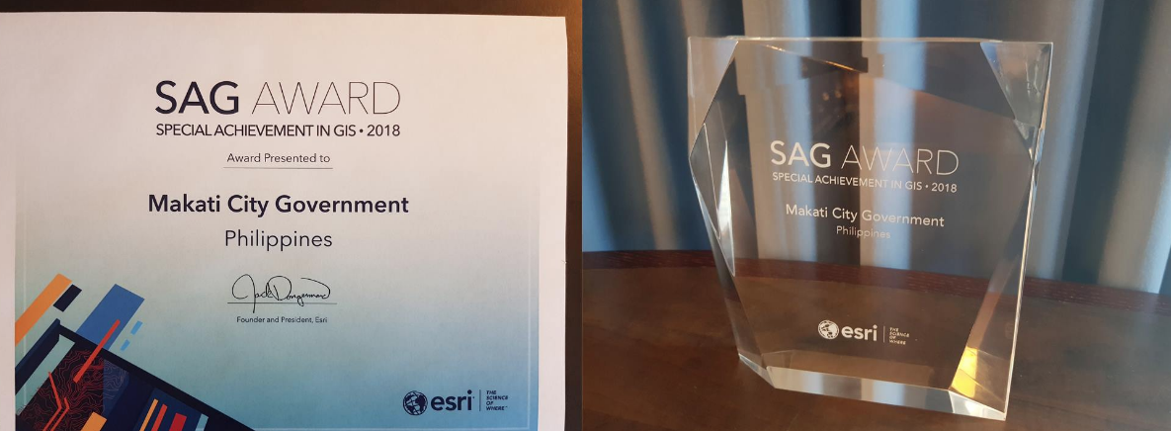
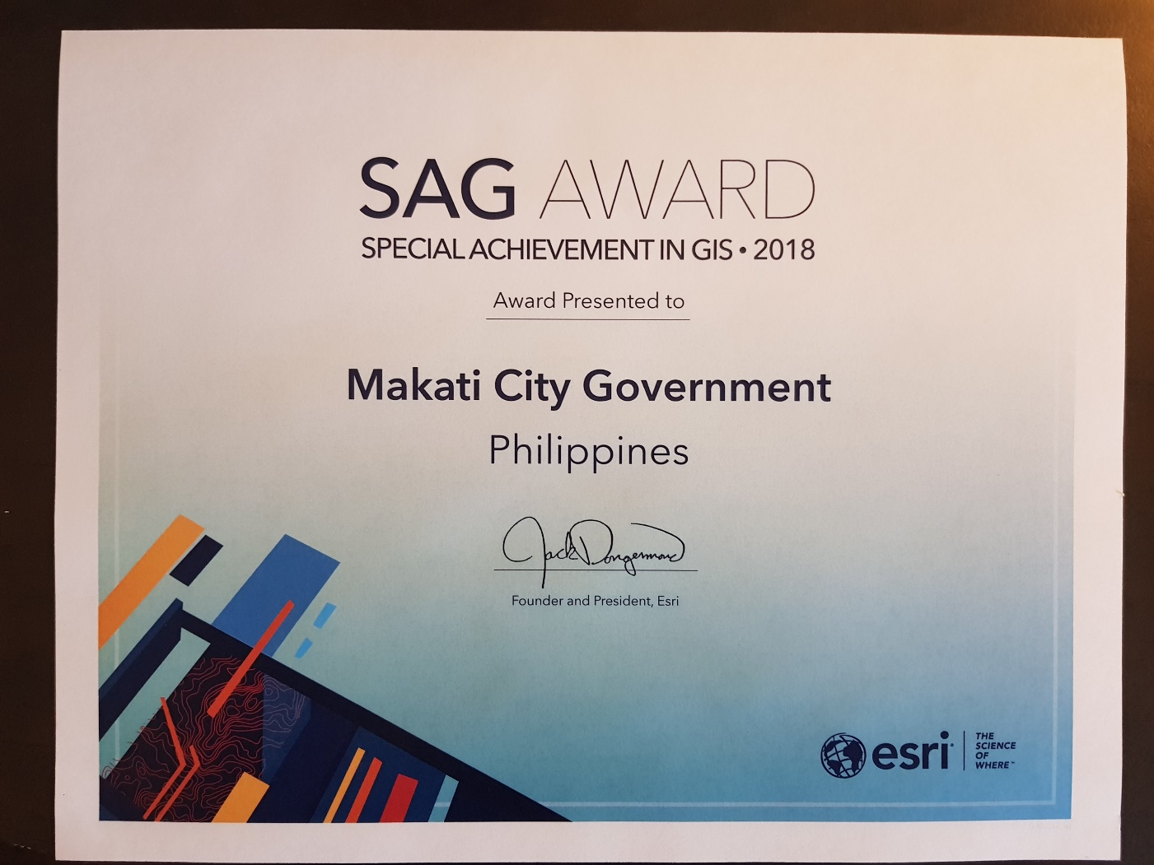
Special Achievement in GIS Award

Slide 13
e-BPLS

Slide 14
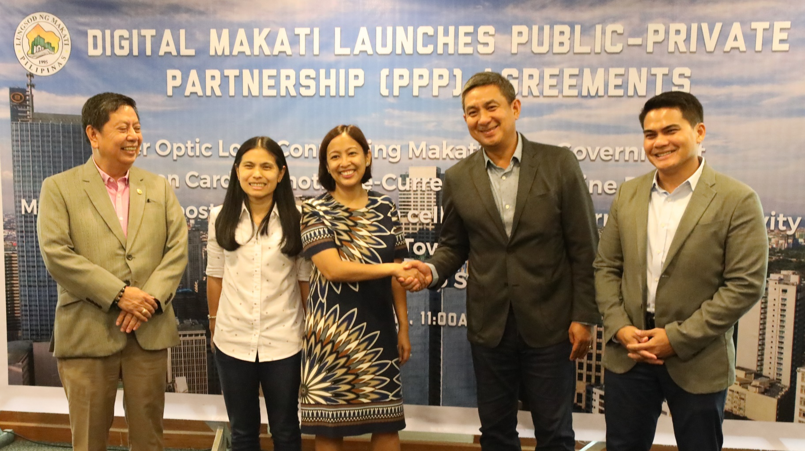
PPP-led Initiatives

Slide 15
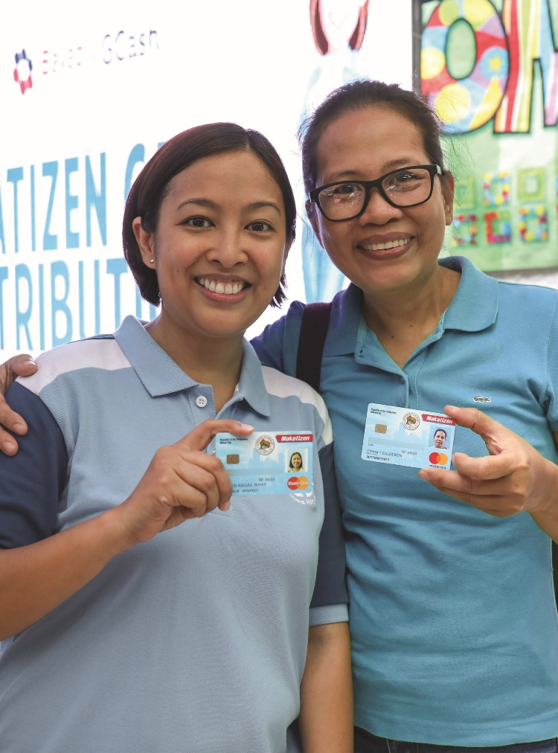
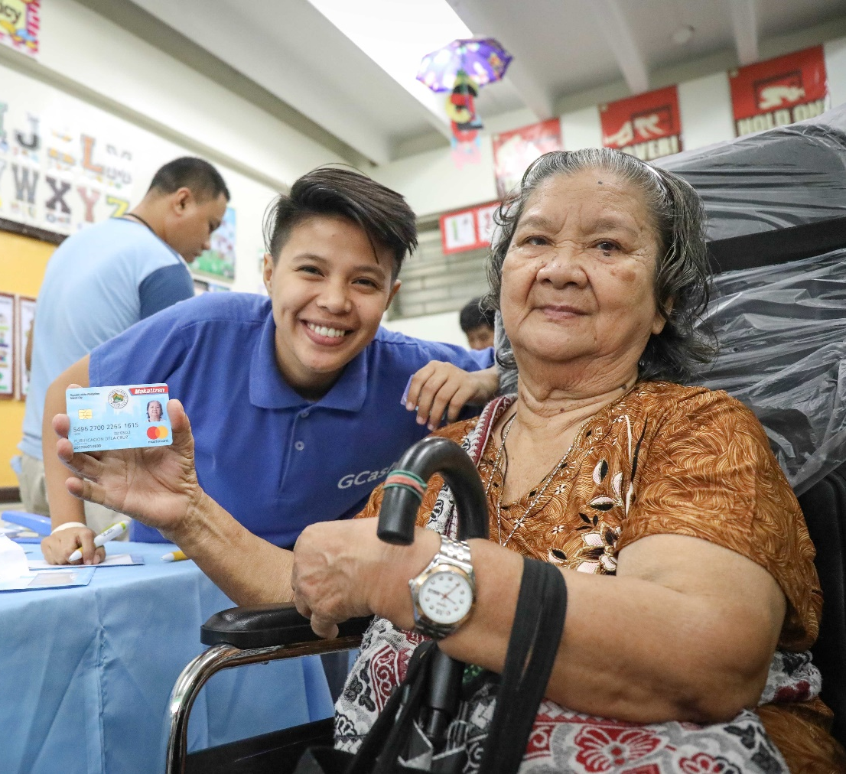
75,000 Makatizen Cards Distributed

Slide 16
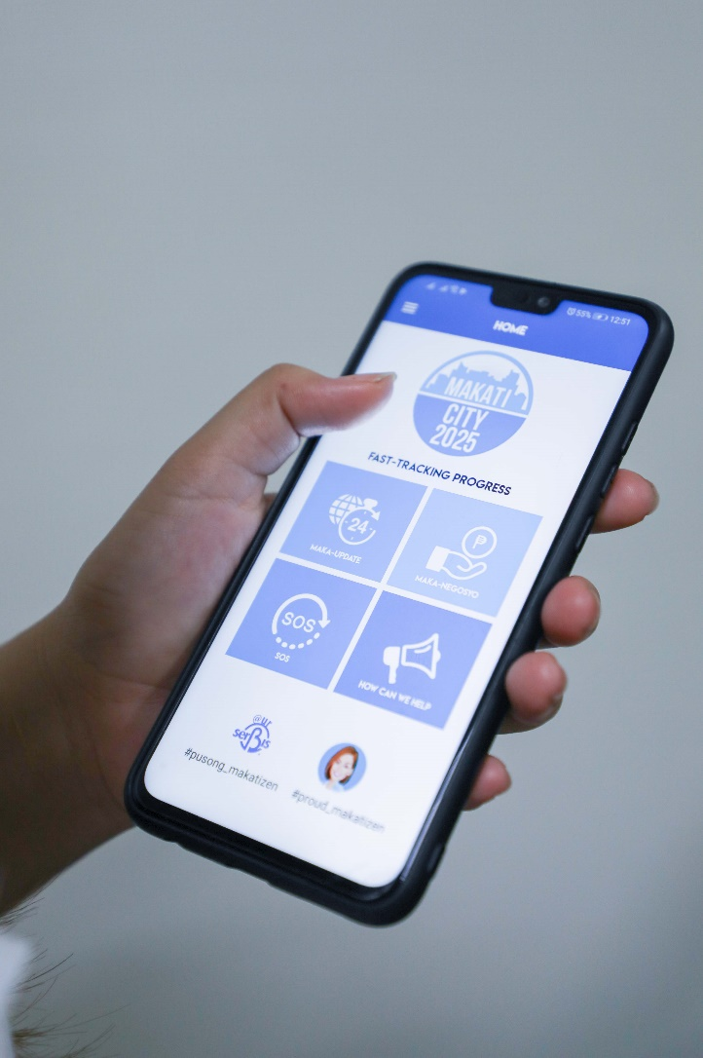
Over 5,000 Users of Makatizen App

Slide 17
Makati Public WiFi System
Phase 1:
100% Complete
Phase 2:
99.36% Complete
Poblacion
Cembo
East Rembo
Guadalupe Viejo
Guadalupe Nuevo
Olympia
Pembo
Pinagkaisahan
Valenzuela
West Rembo
Kasilawan
Carmona
South Cembo
Pitogo
Singkamas
La Paz
Sta. Cruz
San Antonio
San Isidro
Bangkal
Palanan
Rizal
Tejeros
Pio del Pilar

Slide 18
New Programs, Expanded Benefits

Slide 19
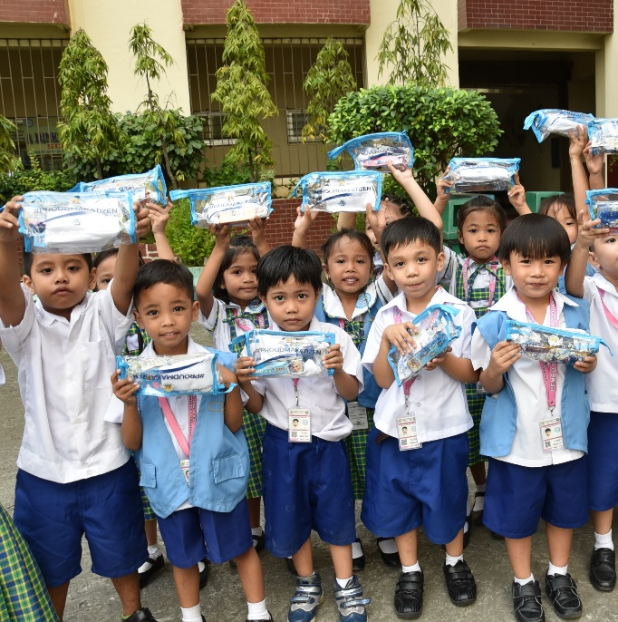
Cutting Edge and Relevant Education
Air Binay 2.0
Rain Gears
Hygiene Kits
Emergency Go Bags

Slide 20
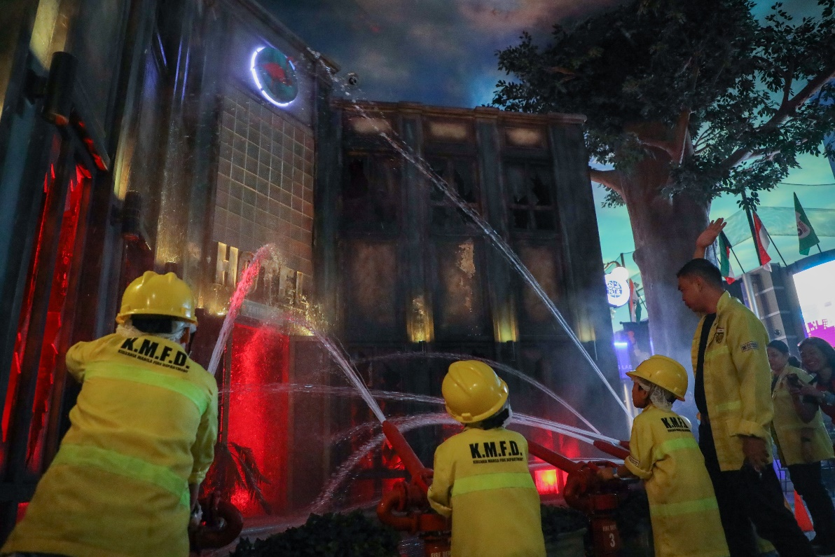
Free Educational Trips

Slide 21
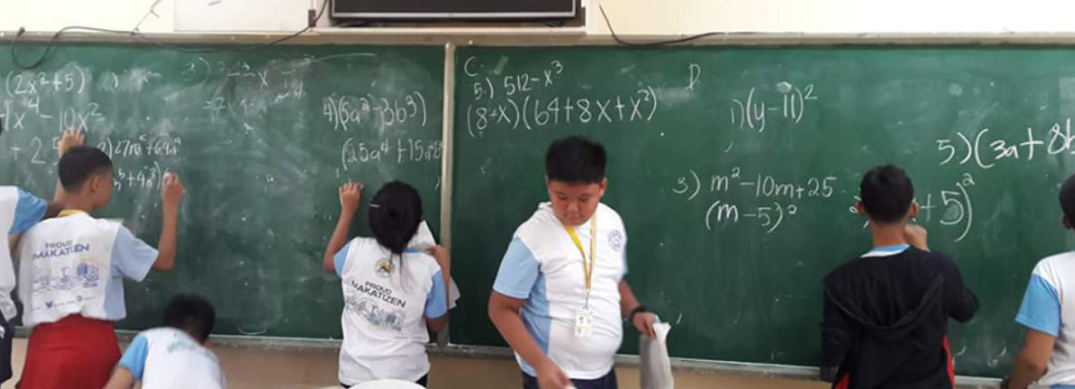
Tutorials for Math Proficiency

Slide 22
Daily Nutritious Meals

Slide 23
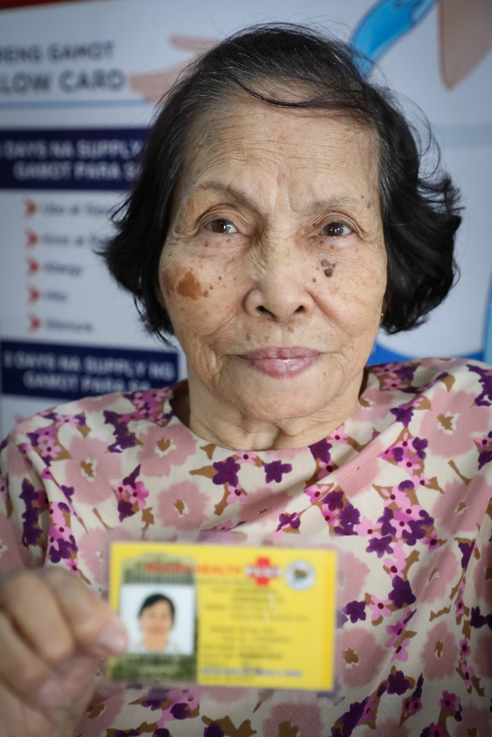
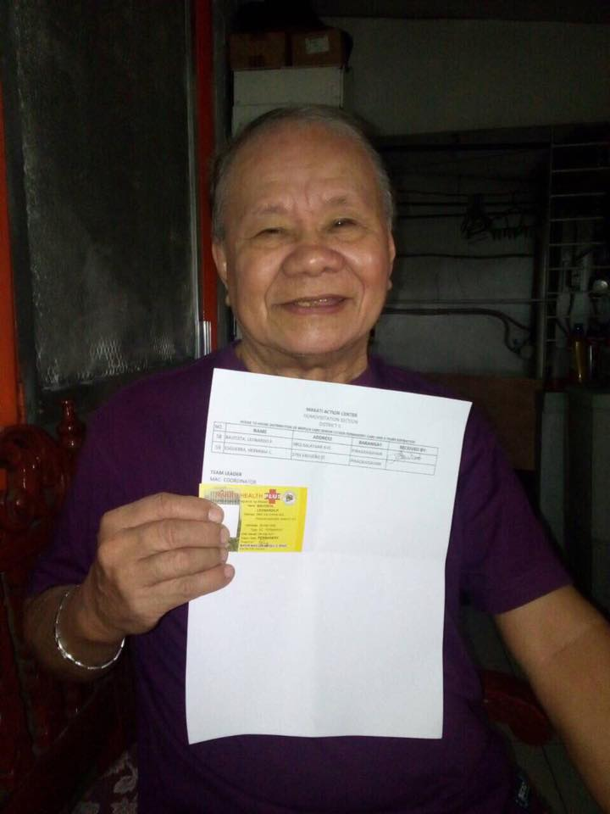
80,000 Yellow Card Holders

Slide 24
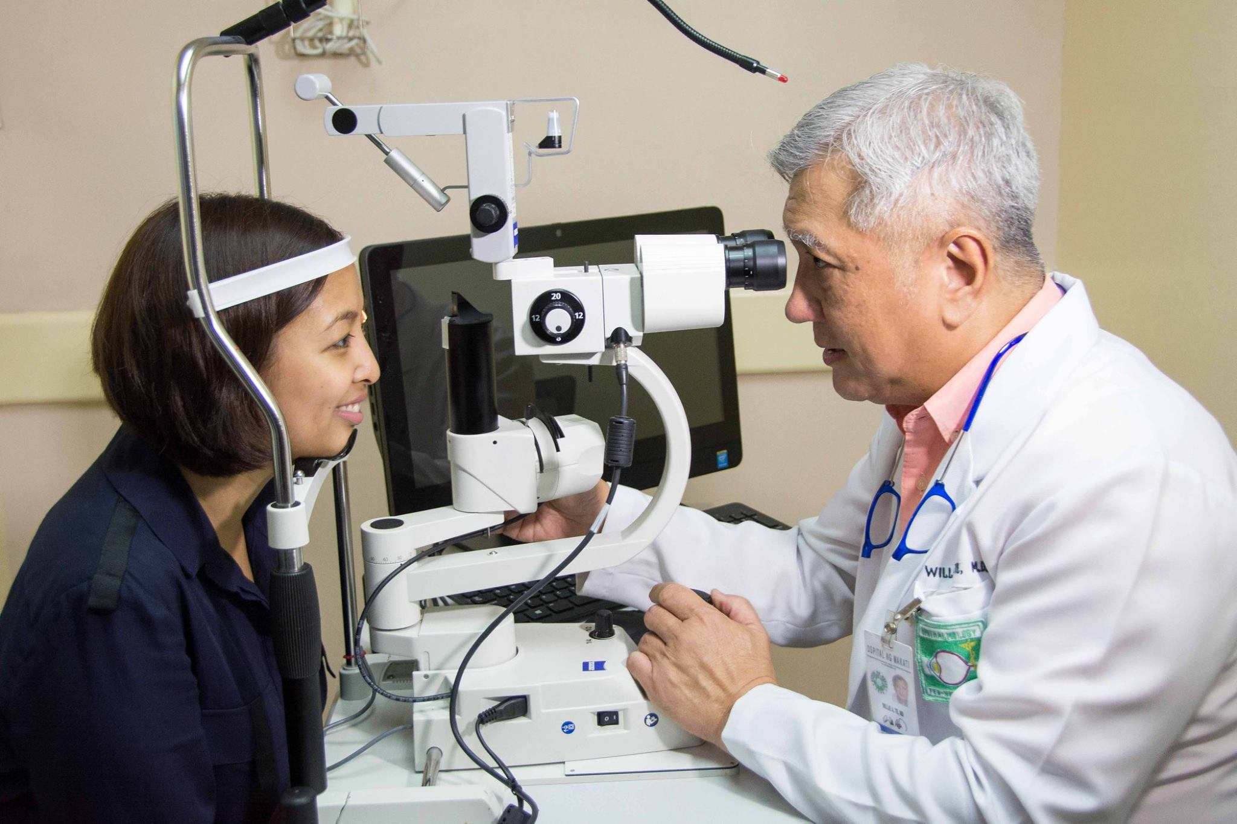
Ospital ng Makati Eye Center

Slide 25
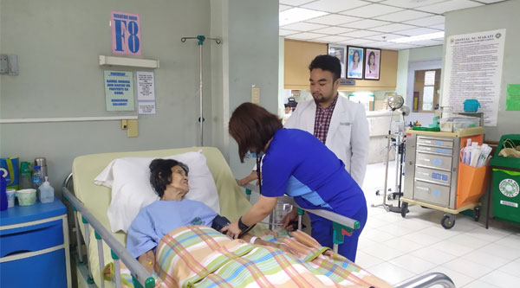
Hospice Care Program

Slide 26
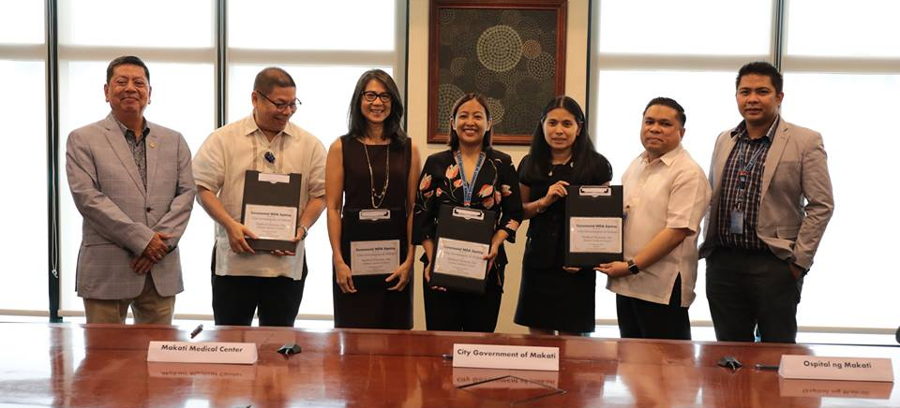
MOA with Makati Medical Center

Slide 27
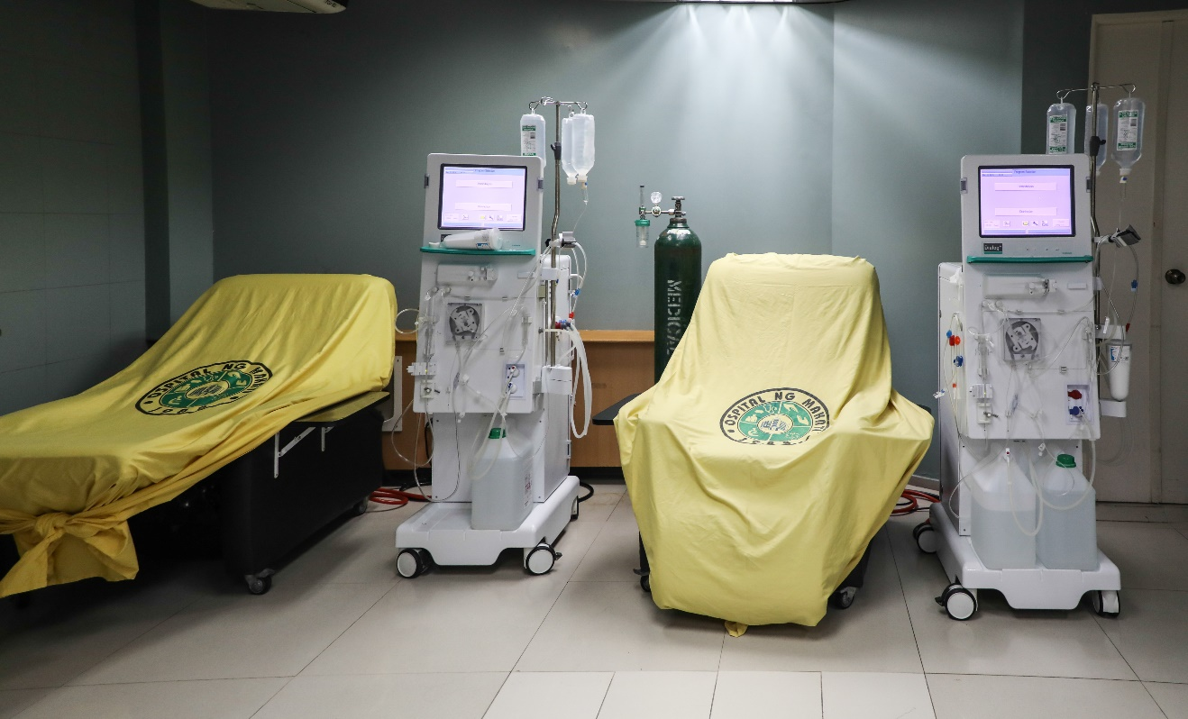
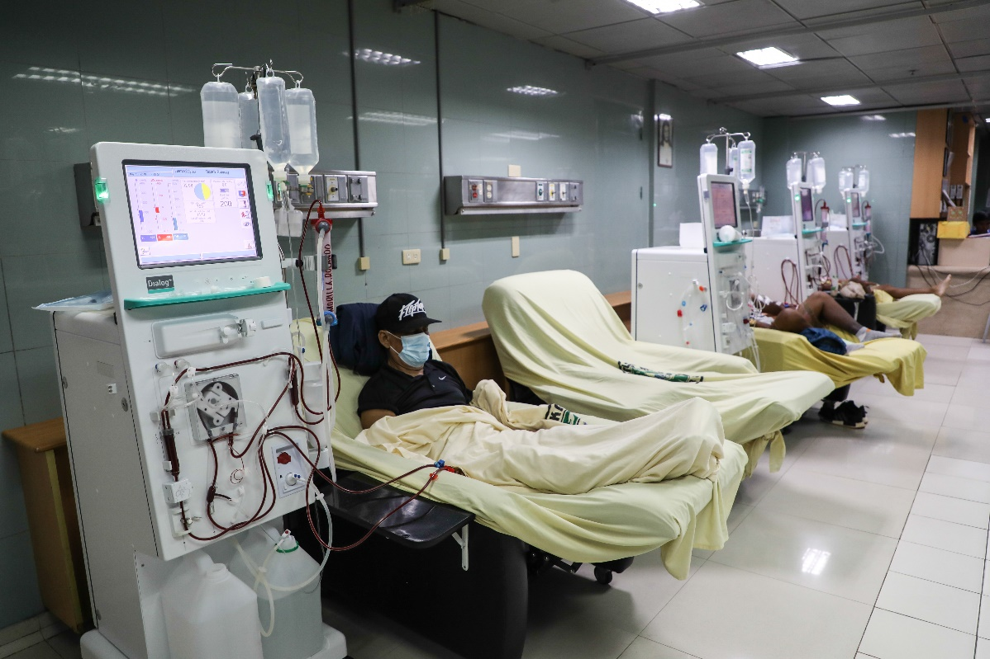
Unli-Dialysis

Slide 28
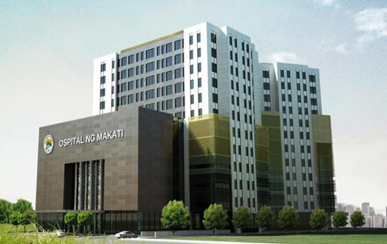
New Ospital ng Makati

Slide 29
Urgent Care Service

Slide 30
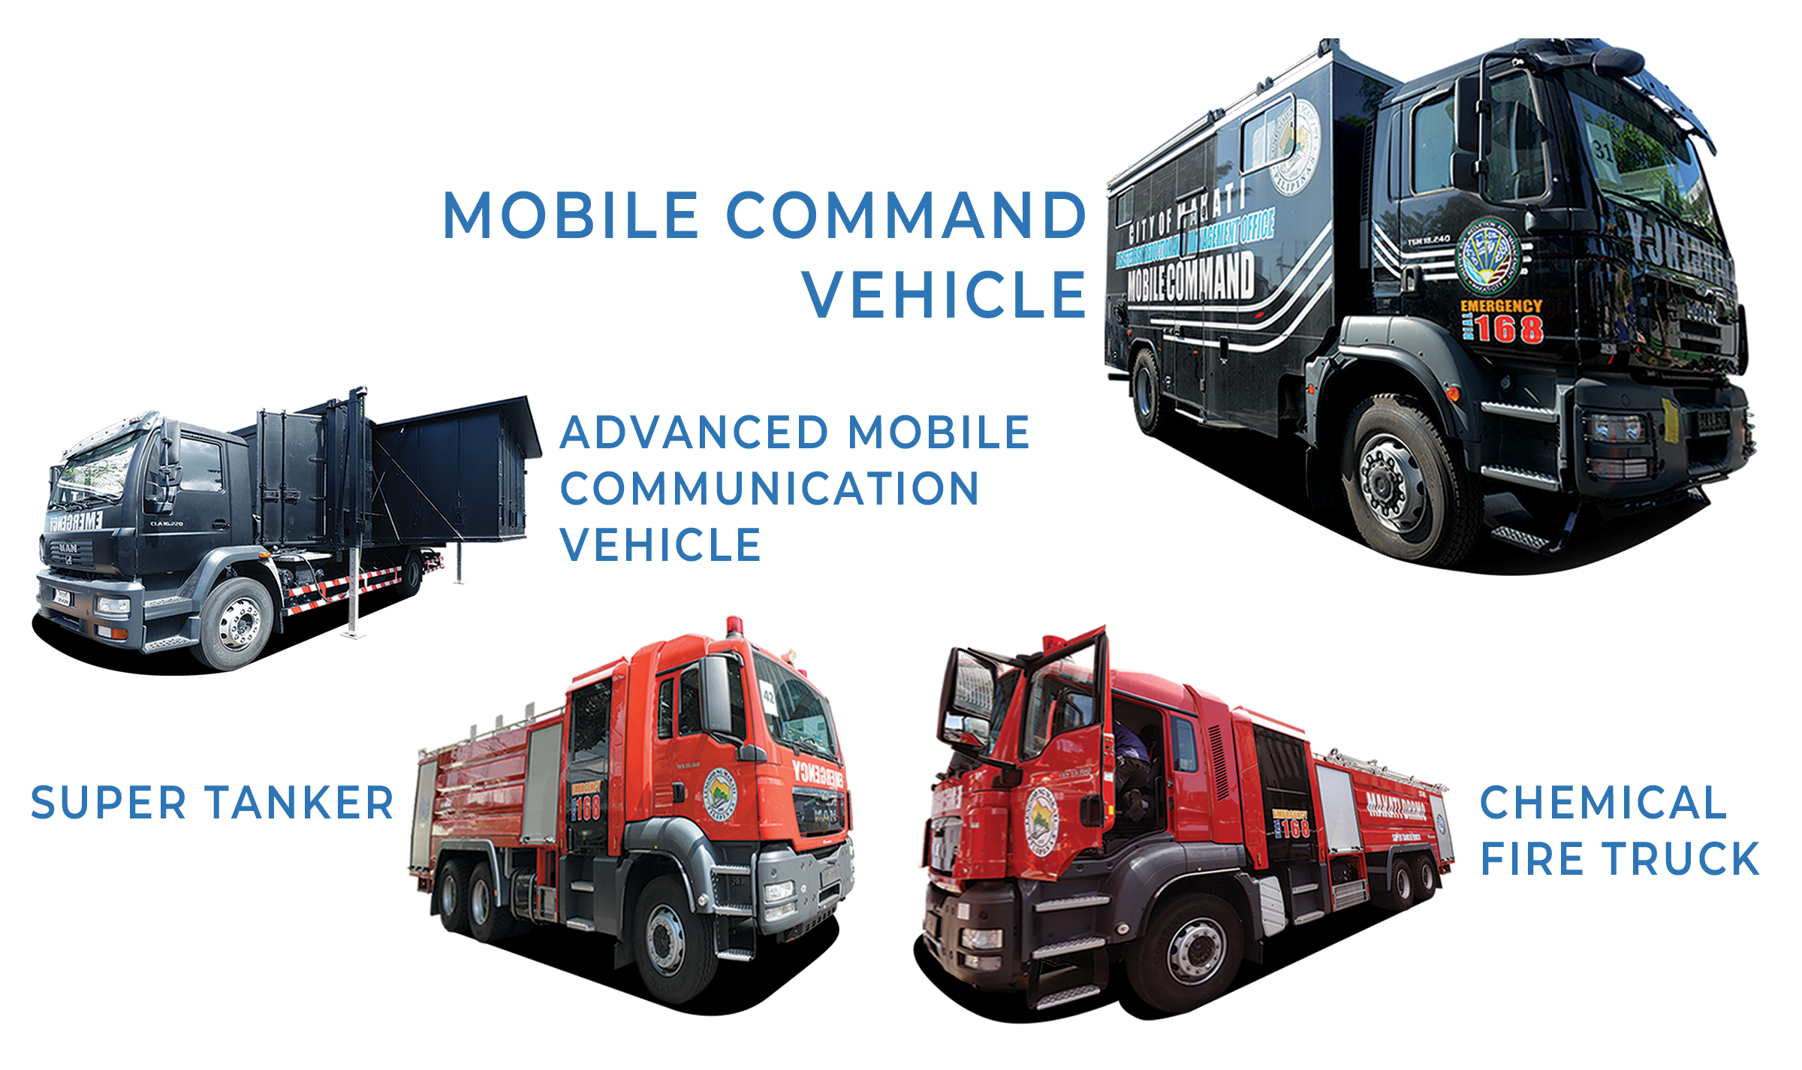

Slide 31
Makati City
Major Infrastructure Projects
2019-2025

Slide 32
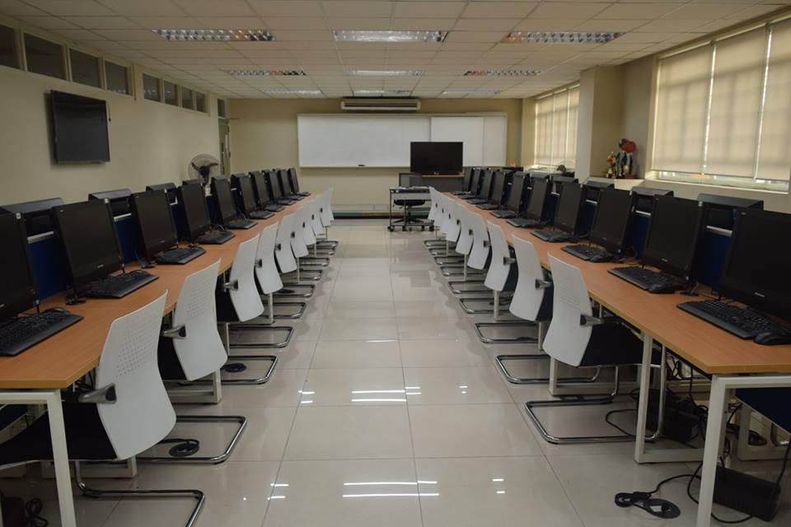
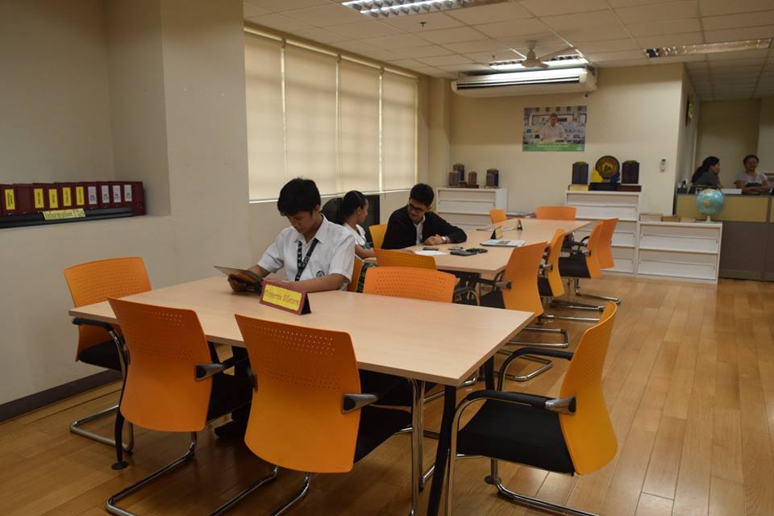
Digital School

Slide 33
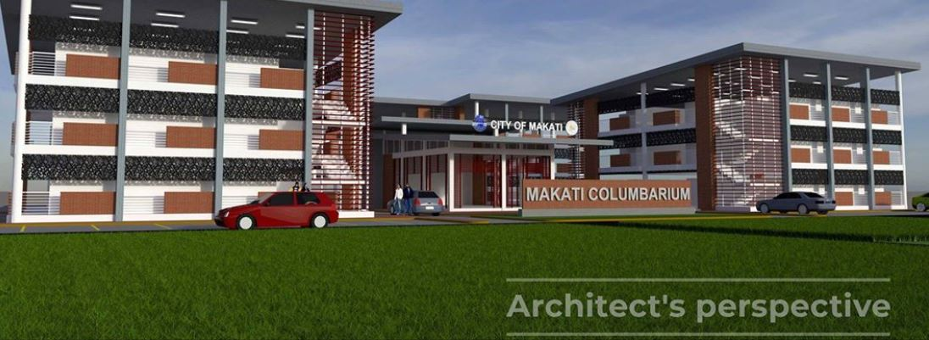
Columbarium

Slide 34
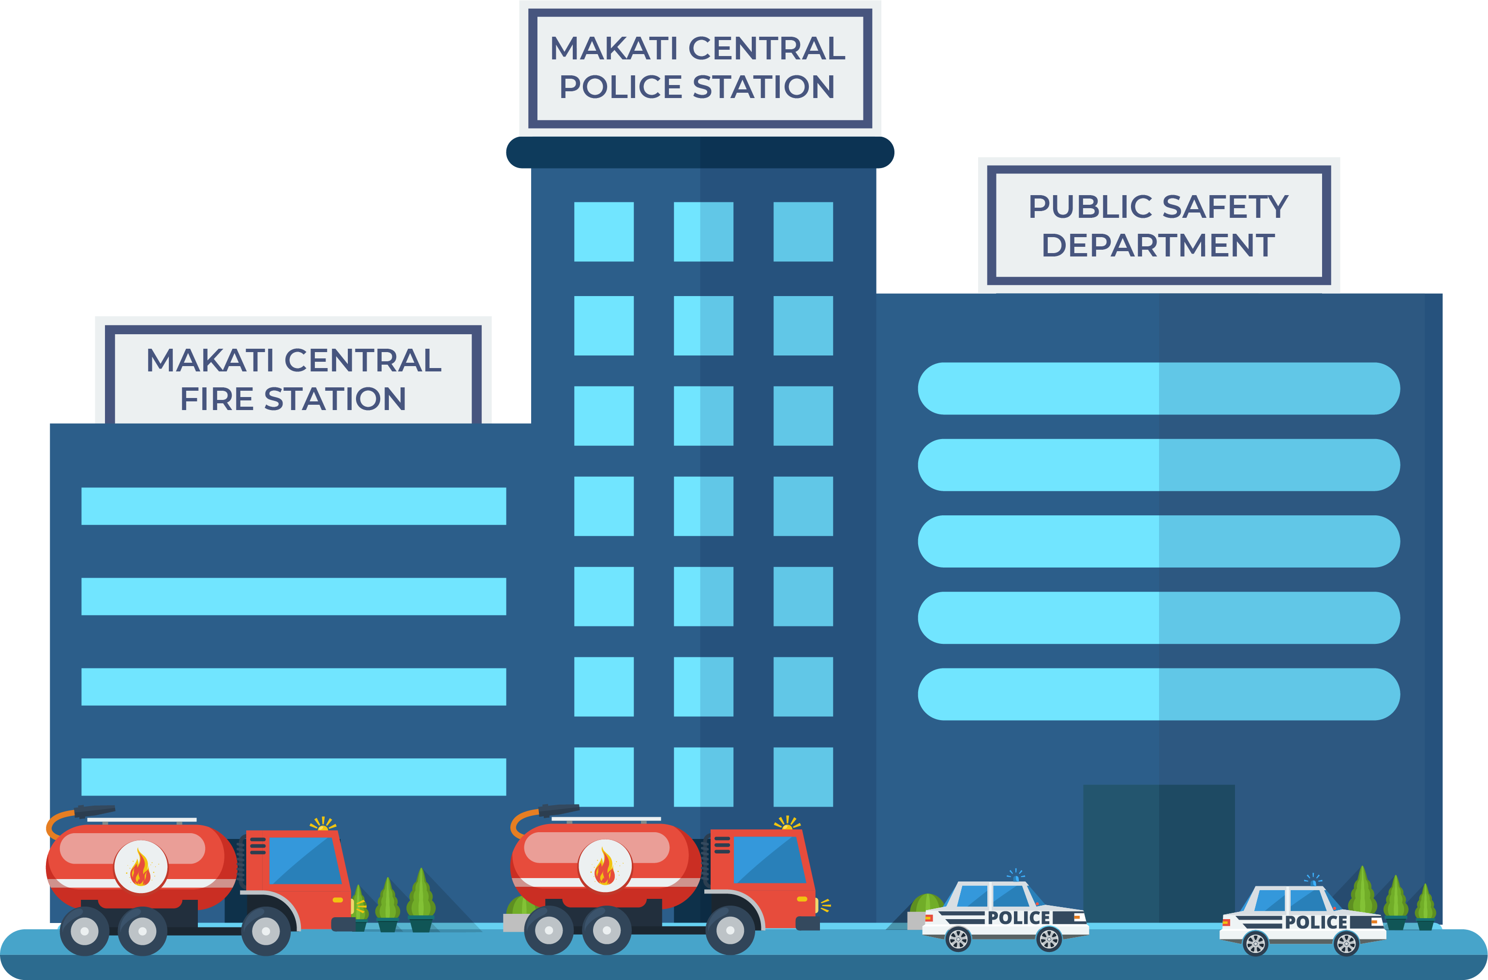

Slide 35
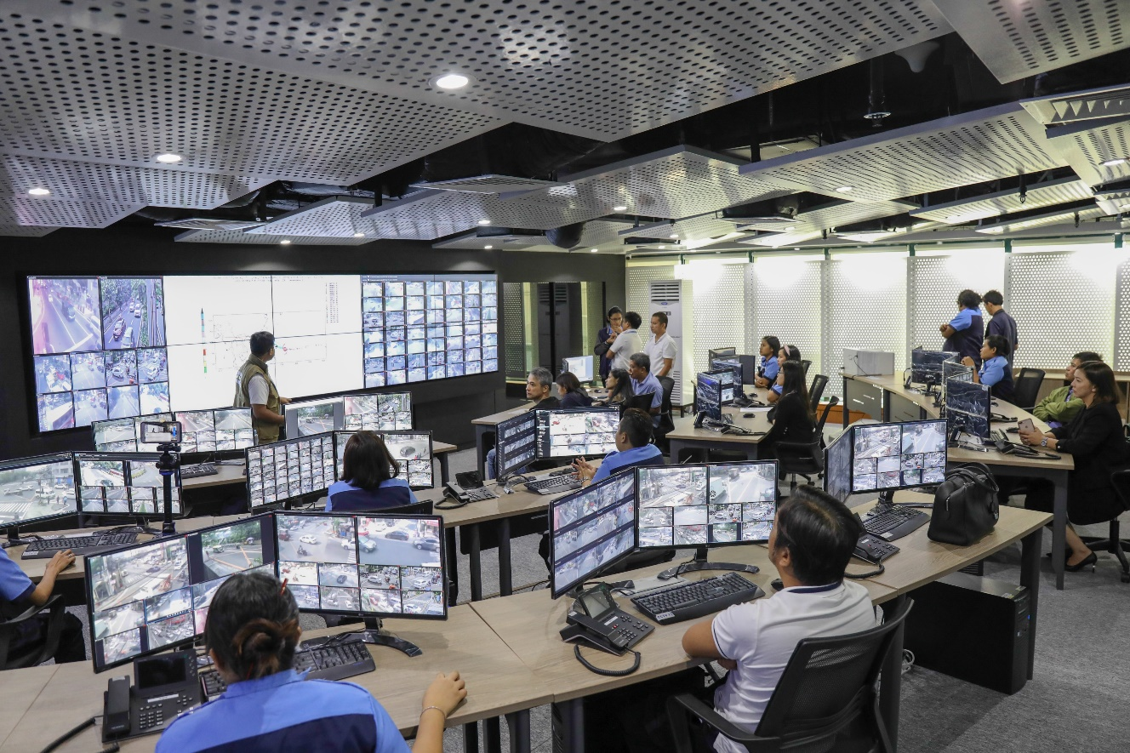
DRRM Makati Building

Slide 36
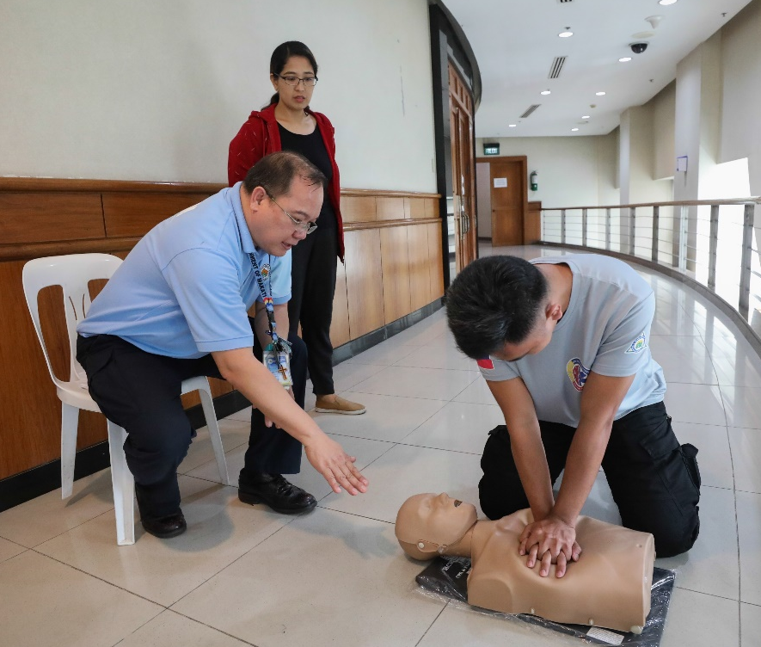
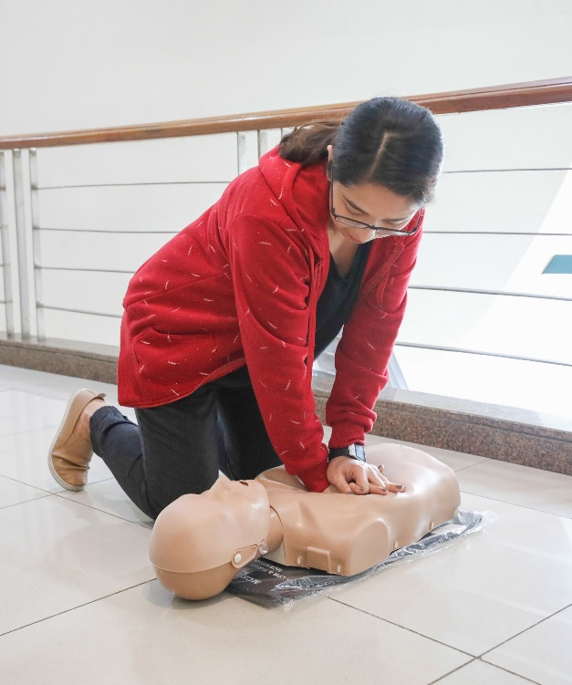
DRRM Academy

Slide 37
Transformational Legacy Project

Slide 38
Makati Subway

Slide 39
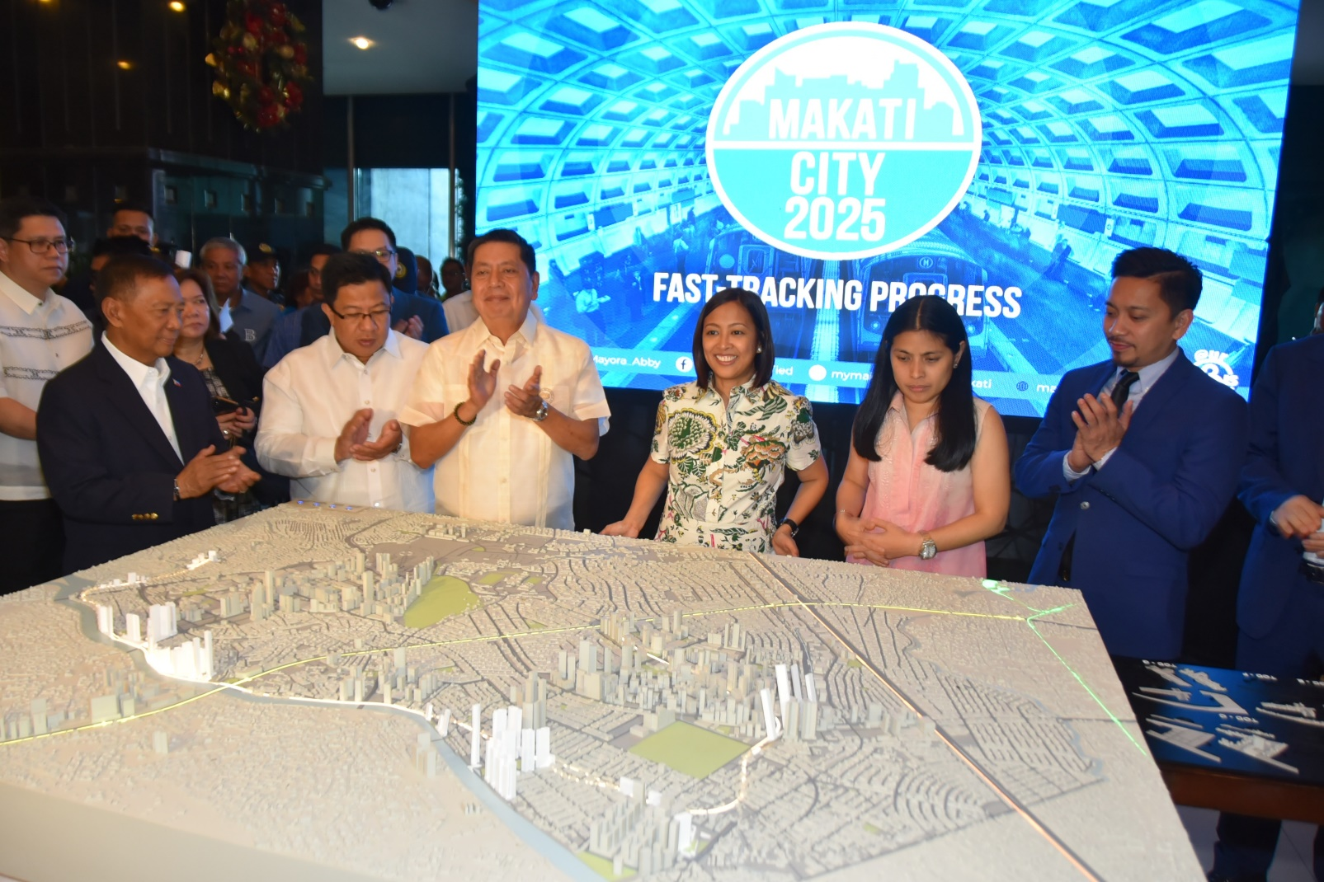
Scale Model of the Makati Subway

Slide 40
Makati Subway Benefits
10,000 jobs
Traffic decongestion
Increased productivity of workers
Business-stimulating
Sustainable development
Economic stability
Reduced GHG emission

Slide 41
Makati Subway : Game-changer
“Catalyst of inclusive and sustainable economic growth
and social progress”

Slide 42
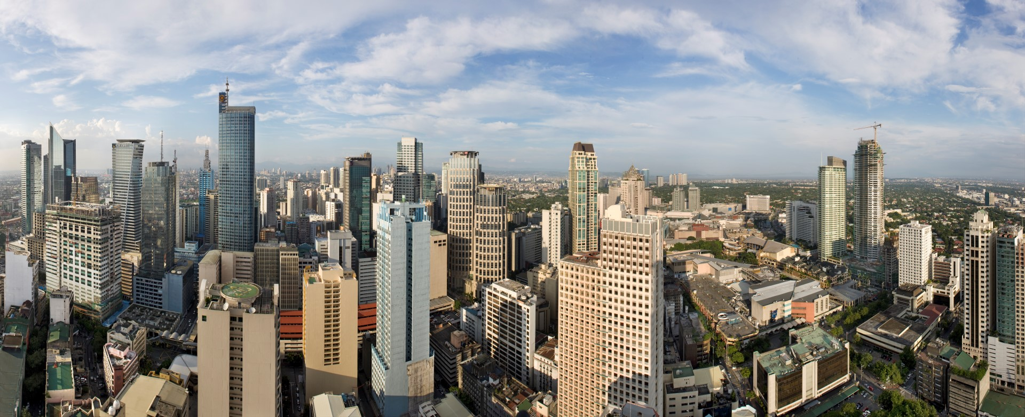
First ‘Smart City’ in the Philippines

Slide 43
Thank you!

